Slide 1
ER MODEL

Slide 2
DATA MODELING
Data models define how the logical structure of a database is modeled
Data models define how data is connected to each other and how they are processed and stored inside the system
One of the Data Modeling Techinque is
Enity-Relationship Model

Slide 3
DATA MODELING
Data modeling is the process of creating a data model for the data to be stored in a Database. This data model is a conceptual representation of
-Data objects
-The associations between different data objects
-The rules
Data modeling helps in the visual representation of data

Slide 4
ER Model
Entity-Relationship (ER) Model is based on the notion of real-world entities and relationships among them
The ER model defines the conceptual view of a database
At view level, the ER model is considered a good option for designing databases

Slide 5
ER Model
In ER modeling, the database structure is portrayed as a diagram called an entity-relationship diagram
ER Model is based on −
Entities and their attributes.
Relationships among entities.

Slide 6
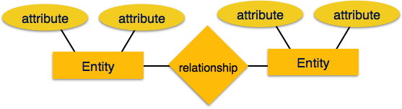
ER MODEL
THIS CONCEPT ARE EXPLAINED FURTHER

Slide 7
ER MODEL
Entity − An entity in an ER Model is a real-world entity having properties called attributes. Every attribute is defined by its set of values called domain. For example, in a school database, a student is considered as an entity. Student has various attributes like name, age, class, etc.
Relationship − The logical association among entities is called relationship. Relationships are mapped with entities in various ways
one to one
one to many
many to one
many to many

Slide 8
NOTATION
In ER modeling, the database structure is portrayed as a diagram called an entity-relationship diagram
Notation
1)UML
2) CROWS FEET
3) CHEN

Slide 9
Notation 1-UML-Entity
Entity
Entity
Entity

Slide 10
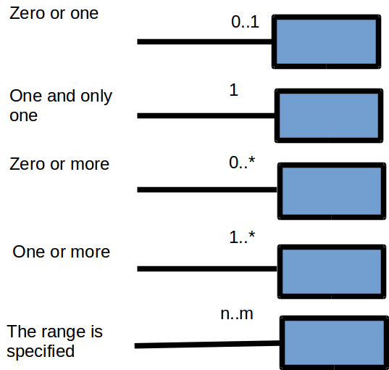
Notation 1-UML-Relationship

Slide 11
Notation 1-UML
Module
1
0...*
Student on
Module
0...*
1
Student

Slide 12
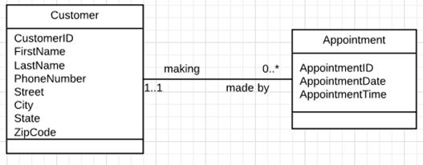
Notation 1-UML-With Attributes

Slide 13
Notation-UML-With Attributes
Module
Attributes:
Module Code(PK)
Module Name
1
0...*
Student on
Module
Attributes:
Module Code (FK)
Student No (FK)
0...*
1
Student
Attributes:
Student No(PK)
Student Name

Slide 14
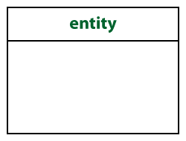
Notation 2- CROWS FEET -Entity
In crow’s foot notation, an entity is represented by a rectangle, with its name on the top. The name is singular (entity) noun rather than plural (entities).

Slide 15
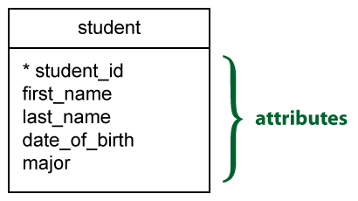
Notation 2- CROWS FEET -Atributes
An attribute is a property that describes a particular entity.
The attribute(s) that uniquely distinguishes an instance of the entity is the identifier. Usually, this type of attribute is marked with an asterisk

Slide 16
Notation 2- CROWS FEET -Relationship
Relationships illustrate the association between two entities. They are presented as a straight line. Usually, each relationship has a name, expressed as a verb, written on the relationship line. This describes what kind of relationship connects the objects.

Slide 17
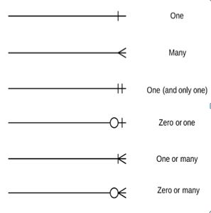
Notation 2- CROWS FEET -Relationship

Slide 18
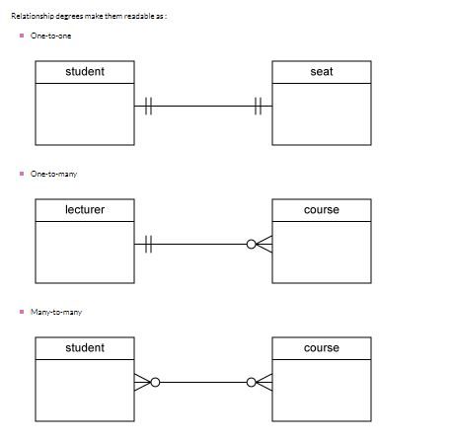
Notation 2- CROWS FEET -Relationship

Slide 19
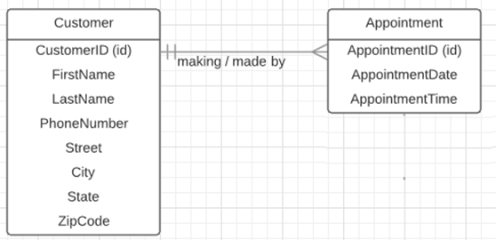
Notation 2- CROWS FEET

Slide 20
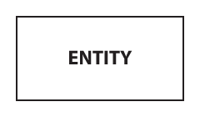
Notation 2- Chen -Entity
In crow’s foot notation, an entity is represented by a rectangle, with its name on the top. The name is singular (entity) noun rather than plural (entities).

Slide 21
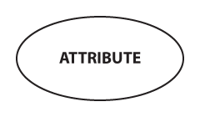
Notation 2- Chen -Attributes
In the Chen notation, each attribute is represented by an oval containing atributte’s name

Slide 22
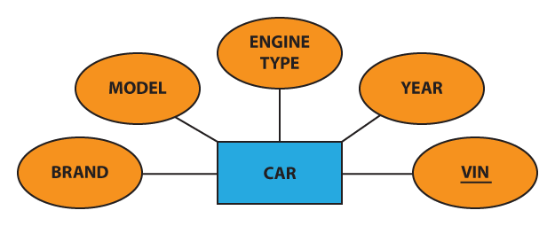
Notation 2- Chen -
Example

Slide 23
Notation 2- Chen -
Example

Slide 24
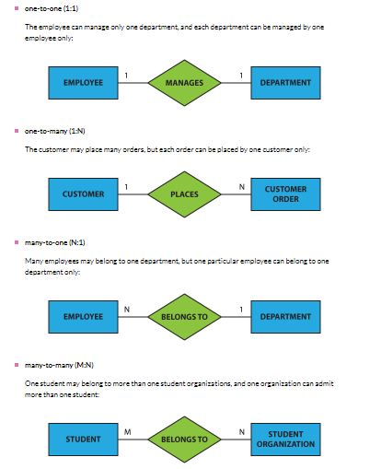
Notation 2- Chen - Relationship

Slide 25
Entity-Entity Type-Entity Set
STUDENT:
Above is an example of a table called Student having 2 rows (1,Ram,12) and (2,Sam,13) . Using this we can understand the difference.
Entity
It is something which has real existence. Like Row1 contains information about Ram(id, name and Age) which has existence in real world . So the Row1 is an entity. So we may say each Row is an entity.
ID | NAME | AGE
1 | Ram | 22
2 | Shyam | 25

Slide 26
Entity-Entity Type-Entity Set
STUDENT:
Entity Type
It is collection of entity having common attribute. As in Student table each row is an entity and have common attributes. So STUDENT is an entity type which contains entities having attributes id, name and Age.Also each entity type in a database is described by a name and a list of attribute.So we may say a table is an entity type
Defination: A group of objects, people, types, concepts or other items that have the same set of properties (known as attributes).
ID | NAME | AGE
1 | Ram | 22
2 | Shyam | 25

Slide 27
Entity-Entity Type-Entity Set
STUDENT:
Entity SET
It is a set of entities of same entity type. so a set of one or more entities of Student Entity type is an Entity Set.
ID | NAME | AGE
1 | Ram | 22
2 | Shyam | 25

Slide 28
Activity
Identify entity types that might exist in a LIBRARY SYSTEM.

Slide 29
Library System ERD
Author
Book
Borrower
Subject

Slide 30
Diagrammatic Representation of Entity Types
Each entity type is shown as a rectangle labeled with the name of the entity, which is normally a singular noun.
In UML, the name of an entity should begin with an upper case letter.
Book

Slide 31
Activity - What Relationships Exist between these Entities? - 1
Book
Author
Borrower
Subject

Slide 32
Organising it Better…
Author
Book
Borrower
Subject

Slide 33
Relationship Names
Author
Writes ↓
Taken out on →
Book
Borrower
← Takes out
Classifies ↑
Subject

Slide 34
Multiplicity - 1
Number or range of possible occurrences of an entity type in relation to another entity type
Multiplicities are of the following types: one-to-one, one-to-many, many-to-one, and many-to-many

Slide 35
Multiplicity - 2
Book
0..*
Classifies ↑
1
Subject
A Book is Classified by ONE subject. But ONE Subject could classify none or many Books.

Slide 36
Multiplicity - 3
Author
1..*
Writes ↓
1..*
Book
0..*
Classifies ↑
1
Subject
A Book is Written by ONE or more Authors. An Author writes one or more Books.

Slide 37
Multiplicity - 3
Author
1..*
Writes ↓
1..*
0..*
0..*
Book
Borrower
0..*
Classifies ↑
1
Subject
A Book is taken out by zero or more Borrower. An borrower takes on zero or more Books.

Slide 38
Library System Complete -ERD
-With Linking or Bridge Table
Author
1
1..*
Book_Author
1..*
1
1
0..*
0..*
1
Book
Loan
Borrower
0..*
1
Subject

Slide 39
ACTIVITIES-SEIF STUDY
Draw the ERD identifying entity types and their relationship of e-commerce site(at least 3 entity types)

Slide 40
Attributes
Entities are represented by means of their properties, called attributes. All attributes have values. For example, a student entity may have name, class, and age as attributes.
There exists a domain or range of values that can be assigned to attributes. For example, a student's name cannot be a numeric value. It has to be alphabetic. A student's age cannot be negative, etc.

Slide 41
Attributes
Types of Attributes
Simple attribute
Composite attribute
Derived attribute
Single-value attribute
Multi-value attribute

Slide 42
Types of Attributes
Simple attribute − Simple attributes are atomic values, which cannot be divided further. For example, a student's phone number is an atomic value of 10 digits.
Composite attribute − Composite attributes are made of more than one simple attribute. For example, a student's complete name may have first_name and last_name.

Slide 43
Types of Attributes
Derived attribute − Derived attributes are the attributes that do not exist in the physical database, but their values are derived from other attributes present in the database. For example, average_salary in a department should not be saved directly in the database, instead it can be derived. For another example, age can be derived from data_of_birth.

Slide 44
Types of Attributes
Single-value attribute − Single-value attributes contain single value. For example − Social_Security_Number.
Multi-value attribute − Multi-value attributes may contain more than one values. For example, a person can have more than one phone number, email_address, etc.

Slide 45
Attribute Domain
A domain is the set of allowable values for an attribute or number of attributes.
A domain therefore limits the values that an attribute can have.
e.g.
Rooms in hotel (1-300)
Age (1-140)
Married (yes or no)
Nationality (Nepalese, Indian, American, or British)
Colors (Red, Yellow, Green)

Slide 46
Relationship Degree
Relationship degree refers to the number of associated entities in a relationship.
The relationship degree can be broadly classified into
Unary(Recursive) relationship
Binary relationship
Ternary relationship

Slide 47
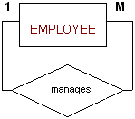
Unary(Recursive) relationship
A unary relationship is when both participants in the relationship are the same entity.
The number of associated entity is one.

Slide 48

Binary relationship
In a binary relationship, two entities are involved.
Consider the example: each department will have many workers.

Slide 49
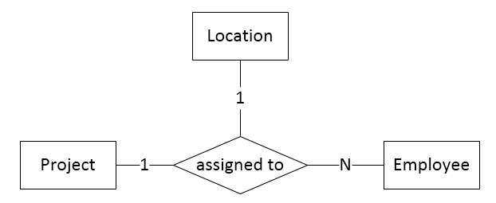
Ternary relationship
In a ternary relationship, three entities are simultaneously involved.
Example : Consider a project is assigned to many employee. And the project is assigned to one location.

